Slide 1
Chapter five
verification and validation
of simulation models

Slide 2
VERIFICATION AND VALIDATION OF SIMULATION MODELS
One of the most difficult problems facing the simulation analyst is determining whether a simulation model is an accurate representation of the actual system being studied( i.e., whether the model is valid).
If the simulation model is not valid, then any conclusions derived from it is of virtually no value.
Validation and verification are two of the most important steps in any simulation project
Validation is the process of determining whether the conceptual model is an accurate representation of the actual system being analyzed.
Validation deals with building the right model.
Verification is the process of determining whether a simulation computer program works as intended (i.e., debugging the computer program).
Verification deals with building the model right.

Slide 3
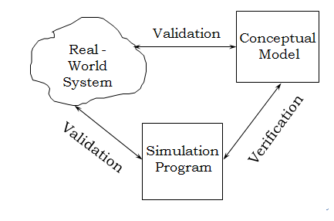

Slide 4
Model Building, Verification and Validation
The first step in model building consists of
observing the real system
observing the interactions among its various components
collecting data on its behavior
The second step in model building is the construction of a conceptual model
a collection of assumptions on the components
structure of the system
hypotheses on the values of model input parameters

Slide 5
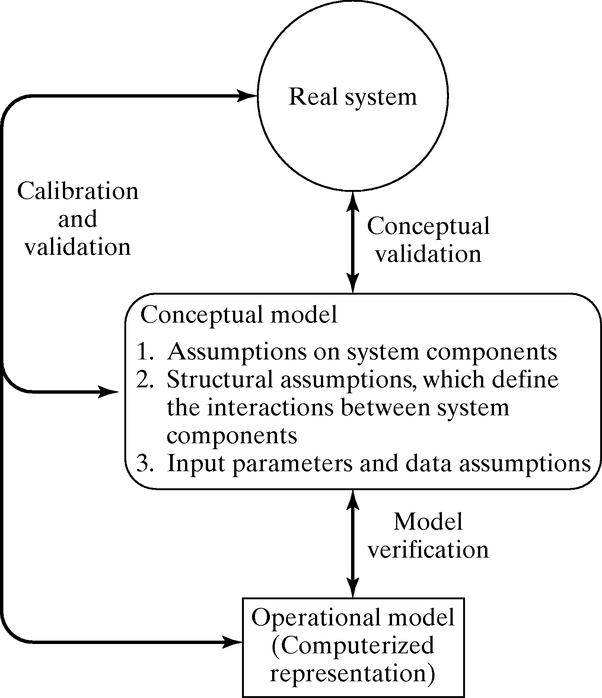
Figure-5.1: Model building, Verification and Validation
The third step is the translation of the operational model into a computer recognizable form of computerized model.

Slide 6
Verification of Simulation Models
The purpose of model verification is to assure that the conceptual model is reflected accurately in the computerized representation.
Suggestions in the verification process
Have someone else check the model.
Make a flow diagram that includes each logically possible action a system can take when an event occurs.
Closely examine the model output for reasonableness under a variety of input parameter settings
Print the input parameters at the end of the simulation, make sure they have not been changed inadvertently.
Make the computerized representation of self-documenting as possible.
Verify the animation imitates the real system
Graphical interfaces are recommended for accomplishing verification & validation

Slide 7
Calibration and Validation of Models
Verification and validation although are conceptually distinct, usually are conducted simultaneously and interactively by the modeler.
Validation: the overall process of comparing the model and its behavior to the real system.
Calibration: the iterative process of comparing the model to the real system and making adjustments.
The following Figure-5.2 shows the relationship of the model calibration to the overall validation process.

Slide 8
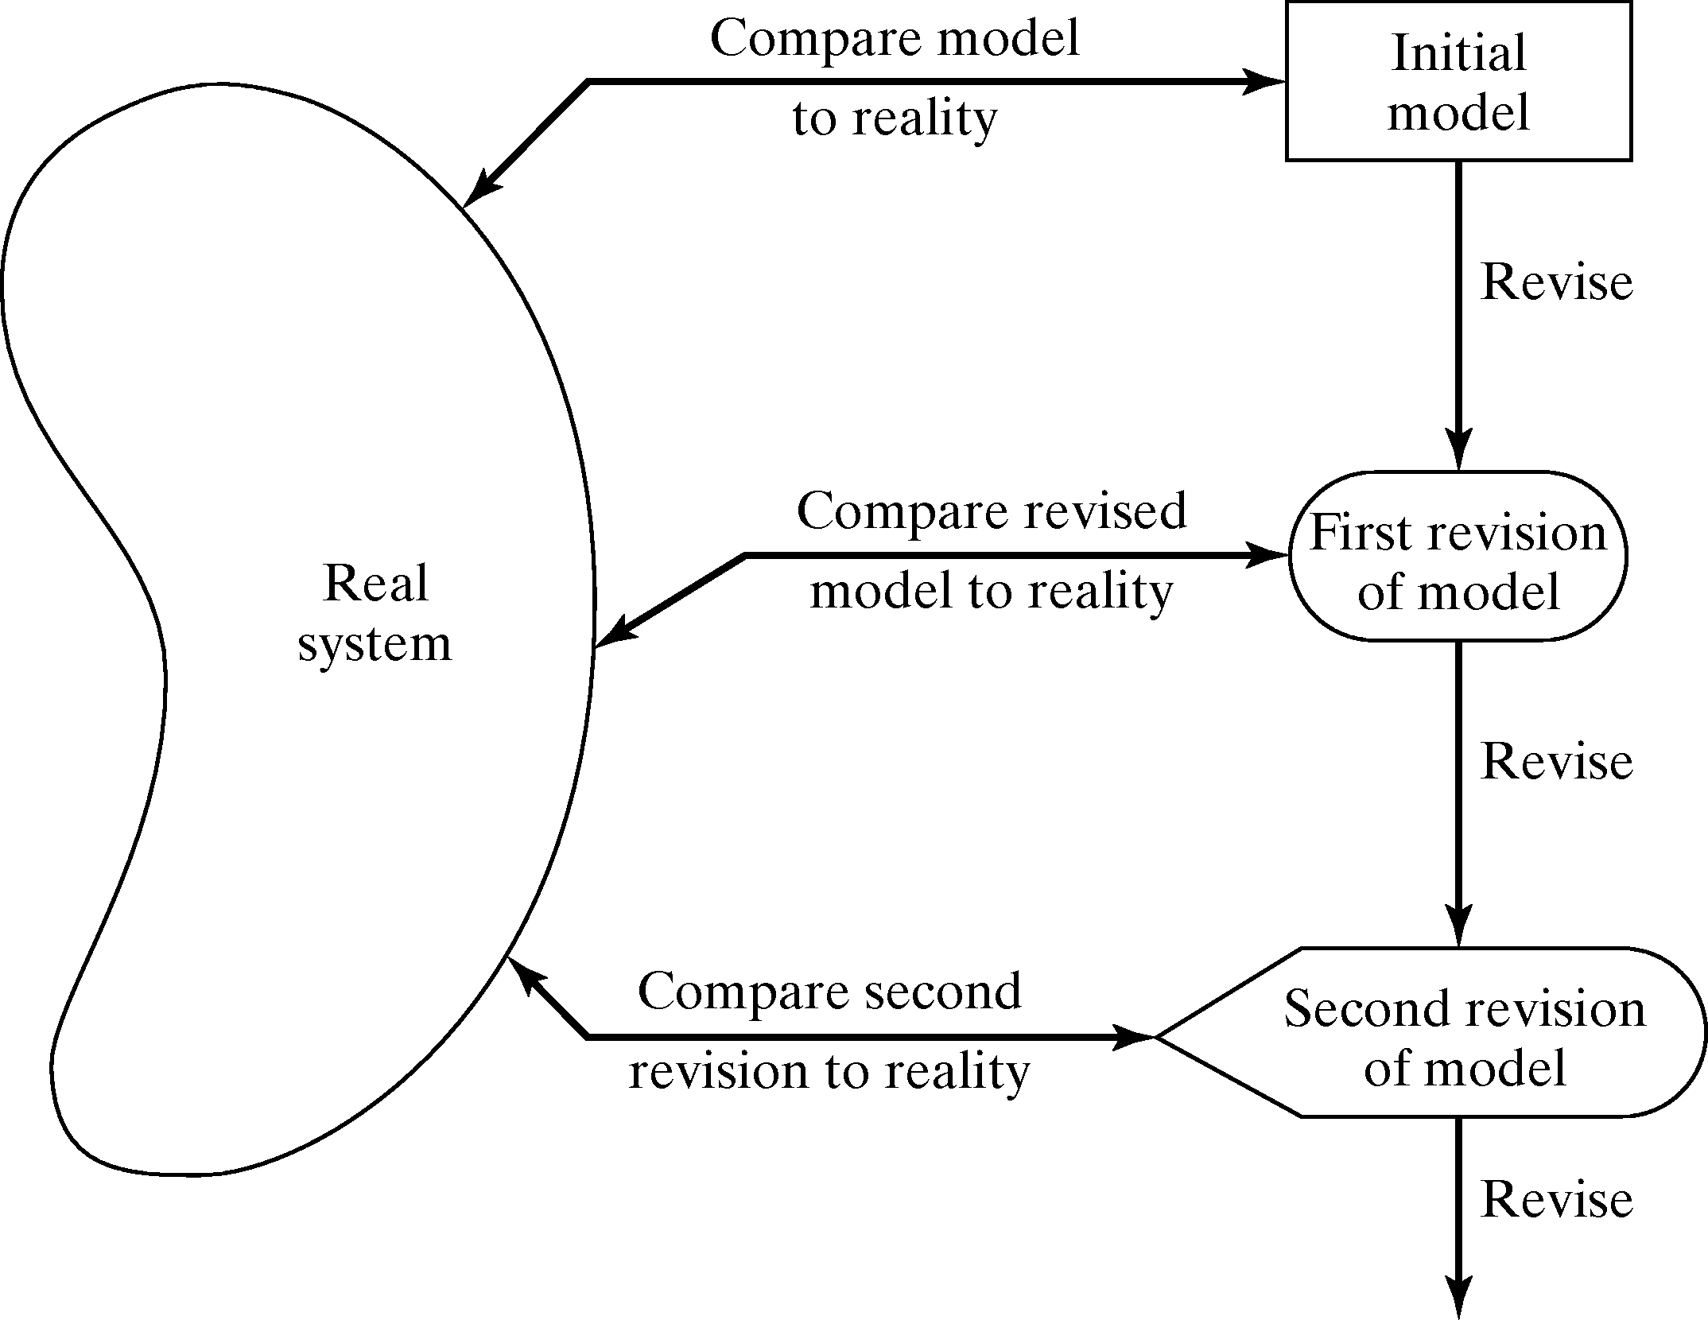
Figure-5.2: Iterative Process of Calibration model

Slide 9
Calibration and Validation
No model is ever a perfect representation of the system
The modeler must weigh the possible, but not guaranteed, increase in model accuracy versus the cost of increased validation effort.
As an aid in the validation process, Naylor and Finger [1967] formulated a three step approach which has been widely followed:-
Build a model that has high face validity.
Validate model assumptions.
Compare the model input-output transformations to corresponding input-output transformations for the real system

Slide 10
FACE VALIDITY
The first goal of the simulation modeler is to construct a model that appears reasonable on its face to model users and others who are knowledgeable about the real system being simulated.
Ensure a high degree of realism: Potential users should be involved in model construction (from its conceptualization to its implementation).
Sensitivity analysis can also be used to check a model’s face validity.
Example: In most queuing systems, if the arrival rate of customers were to increase, it would be expected that server utilization, queue length and delays would tend to increase.

Slide 11
Validation of Model Assumptions
General classes of model assumptions:
Structural assumptions: how the system operates and usually involve simplification and abstractions of reality.
For Example consider the customer queuing and service facility in a bank. customer waiting in one line versus many lines, served FCFS versus priority
Data assumptions: should be based on the collection of reliable data and correct statistical analysis of the data.
For Example interarrival time of customers, service times for commercial accounts
Verify data reliability with bank managers.
Test correlation and goodness of fit for data

Slide 12
Analyzing of input data
The procedure for analyzing input data consist of three steps:
Identifying the appropriate probability distribution.
Estimating the parameters of the hypothesized distribution.
Validating the assumed statistical model by goodness of fit test such as the Chi-square test methods.

Slide 13
Validate I-O Transformations
Goal: Validate the model’s ability to predict future behavior
The only objective test of the model as a whole.
If input variables were to increase or decrease, model should accurately predict what would happen in the real system
The structure of the model should be accurate enough to make good predictions for the range of input data sets of interest.
In this process the model is viewed as an input-output transformation
One possible approach: use historical data that have been reserved for validation purposes only.
Criteria: use the main responses of interest.
If model is used for different purpose later, revalidate it

Slide 14
If the system is in planning stage and no system operating data can be collected, complete input-output validation is not possible.
Validation increases modeler’s confidence that the model of existing system is accurate.
Changes in the computerized representation of the system, ranging from relatively minor to relatively major include :
Minor changes of single numerical parameters such as speed of the machine, arrival rate of the customer etc.
Minor changes of the form of a statistical distribution such as distribution of service time or a time to failure of a machine.
Major changes in the logical structure of a subsystem such as change in queue discipline for waiting-line model, or a change in the scheduling rule for a job shop model.

Slide 15
Major changes involving a different design for the new system such as computerized inventory control system replacing a non computerized system .
If the change to the computerized representation of the system is minor such as in items one or two these change can be carefully verified and output from new model can be accepted with considerable confidence.

Slide 16
Input-Output Validation: Using Historical Input Data
An alternative to generating input data:
Use the actual historical record.
Drive the simulation model with the historical record and then compare model output to system data.
In the bank example, use the recorded interarrival and service times for the customers
Procedure and validation process: similar to the approach used for system generated input data.

Slide 17
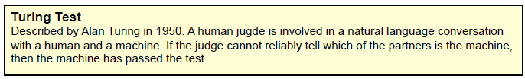
Input-Output Validation: Using a Turing Test
Use in addition to statistical test, or when no statistical test is readily applicable.
Utilize persons’ knowledge about the system.
For example:
Present 10 system performance reports to a manager of the system. Five of them are from the real system and the rest are “fake” reports based on simulation output data.
If the person identifies a substantial number of the fake reports, interview the person to get information for model improvement.
If the person cannot distinguish between fake and real reports with consistency, conclude that the test gives no evidence of model inadequacy.

Slide 18
THANK YOU ?

